Slide 1


Risk Analysis and Support System for Children with ASD Using IoT
Presented by
Susmita Debnath
191002076
Tahiya Akter
191002213
Shartaz Yeasar Feeham
191002130
Supervised by
Md. Solaiman Mia
Assistant Professor
Department of CSE
Green University of Bangladesh

Slide 2
Introduction
Motivation
Contents
Objectives
Literature Review
Problem Description
Draft Plan
Conclusions
References

Slide 3

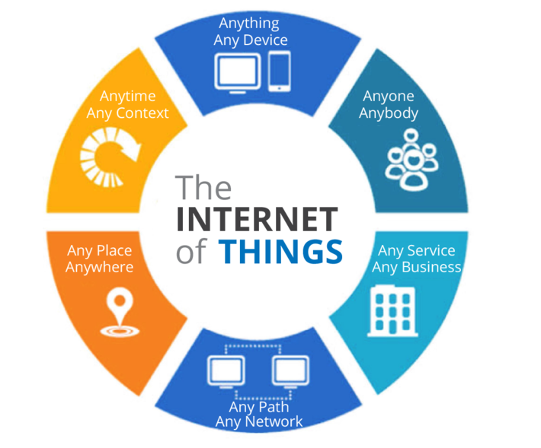
INTRODUCTION
Autism Spectrum Disorder (ASD) is a medical condition that occurs in children which affects communication and behavior of a kid.
Internet of Things (IoT) is simply a network of “things” that are connected to the internet so they can share data with each other.

Slide 4
MOTIVATIONS
Acquiring knowledge
Assuring safety
High availability of IoT
Those child are interested in technology
IoT’s previous success

Slide 5
OBJECTIVES
Aims for observing and analyzing risk
To examine the extent, range, and efficiency of IoT
To make a portable system that can assist parents
To build to build up a less costly, available, easy affordable system

Slide 6
PROBLEM DESCRIPTION
The problem
Why
is it
What can be done
What can not be done
Autism children deserve to be observed without being treated like they are caged.
For being not observed they are getting in risk.
For being over observed they are being caged.
IoT has a big role in healthcare but not enough in this field.
Acknowledgement system for parents.
Calming section for the child.
Risk analysis and safety assurance.
Can be a little costly for individuals.
Limited range.
Can catch up certain situations only.

Slide 7
LITERATURE REVIEW
Autism Support System using RFID Technology
Working process
Pros
Drawback
Scope of improve-ment
Identifies the location of ASD child and informs parents using RFID.
Old style common technology, low cost, available tools, easy to implement
Backdated GSM, low range, RFID can only detect physical scenarios
Updated communication technology can be used, ther additional sensors can improve capability

Slide 8
LITERATURE REVIEW
A support system for autistic children using Internet of Things technology
Working process
Pros
Drawback
Scope of improve-ment
Uses advanced computing device and multiple sensors to observe the children and acknowledge parents
WiFi for communication, double computing device, calming section
Costly & rare components, complex implementation, large device
Size can be reduced
Two way calming section could be added

Slide 9
LITERATURE REVIEW
Emotion Recognition of Autism Children Using IoT
Working process
Pros
Drawback
Scope of improve-ment
Introduces a strategy which utilizes thermal infrared (IR) information as special data to detect the facial expression of ASD child and analyze their status.
More friendly to the use, effective in social problematic scenarios, doesn’t use multiple sensors
IR cameras can not detect behind obstacles.
Some ASD child make abnormal facial expressions.
Could be added some physical analysis devices.
Additional algorithms for more expression detection

Slide 10
LITERATURE REVIEW
Role of IoT and ML for autistic people
Working process
Pros
Drawback
Scope of improve-ment
This paper does a comparative study about the various systems currently being used for monitoring the autistic patients’ health and how it can be used for screening of autistic children.
Polysomnography, pulse rate sensor, eye tracking glasses
Pulse rate sensor reader is placed inside the body. Sensitive and stationary.
Could use external sensing devices.
Acknowledgement systems can be added.

Slide 11
FLOW CHART
Temperature sensing
Acknowledge parents
Pressure sensing
Start calming section
Start
Environment Analysis
Risk found?
Gas sensing
Smoke sensing
End
Acceleration check

Slide 12
DRAFT PLAN (PROJECT PLAN)
Initial works
Selection of research field
Similar works literature study
Data collection and analysis
Implement
Interests, ideas, formulation of research topic
Research proposal, proposal presentation, idea discussion
Starting phase
Similar work limitation and solution
First draft and second draft preparation
Collecting components and implementation
Accuracy analysis, drawback finding, result analysis
Finalization
Fixing previously found drawbacks
Additional works
Final draft writing, submission

Slide 13
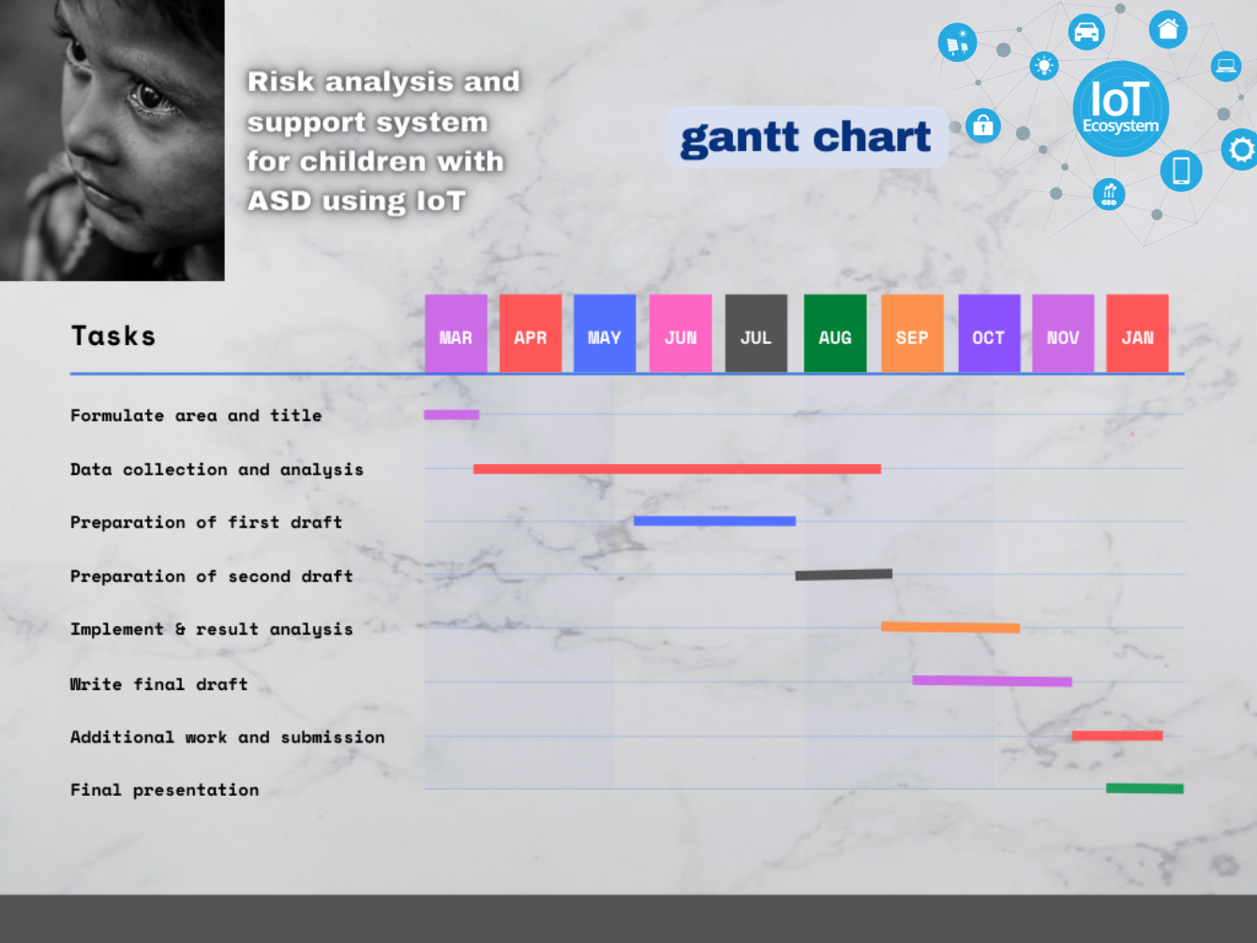
Fig: DRAFT PLAN (GANTT CHART)

Slide 14
DRAFT PLAN (BUDGET)
TYPES | SI | COMPONENTS | COST PER UNIT(TK) | NUMBER OF UNITS | TOTAL COST | MOUSSELINES ADJUSTMENT
Computer | 01 | Arduino Uno | 950 | 1 | 950 | 1045
 | 02 | Particle photon | 2000 | 1 | 2000 | 2200
Sensors | 03 | Temperature | 400 | 1 | 400 | 440
 | 04 | Accelerometer 3D | 400 | 1 | 400 | 440
 | 05 | Pressure | 300 | 1 | 300 | 330
 | 06 | Gas and smoke | 250 | 2 | 500 | 550
 | 07 | RFID | 190 | 1 | 190 | 210
Others | 08 | Wi-Fi module | 450 | 1 | 450 | 485
 | 09 | Battery | 400 | 1 | 400 | 440
 | 10 | Wires | 100 | - | 100 | 110
 | 11 | Audio Device | 300 | 2 | 600 | 660
 | 12 | Extra | 500 | - | 500 | 550
Total |  |  |  |  | 6790 | 7469

Slide 15
CONCLUSION
Costly, as there is a lot of components to add
Hard to make handy and easy carriable
ASD child problems and barriers
Availability and high capability of IoT devices
Risk analysis and acknowledgement systems
Multi situation catch up and communication

Slide 16
REFERENCES
[1] A. S. Agnal, S. Janani, C. Maneesha and K. Ramya, "Autism Support System using RFID Technology,“ International Journal of Engineering and Advanced Technology (IJEAT), October 2019.
[2] N. M. Abdullah and A. F. AL-Allaf, “A support system for autistic children using Internet of Things technology,” 2021 International Conference on Advanced Computer Applications, 27 March 2021.
[3] K. Lavanya, S. M. Anitha, J. Joveka, R. Priyatharshni and S. Mahipal, “Emotion Recognition of Autism Children Using IoT,” International Journal of Applied Engineering Research, 6 Number 2019.
[4] S. Dedgaonkar, Dr. R. K. S. Bedi, K. Kothari, R. Loya and Dr. S. Godbole, “Role of IoT and ML for autistic people,” International Journal of Future Generation Communication and Networking, June 2020.

